Slide 1
The Role of Cloud Computing in Modern Business
Name : 25K-0610 – Muhammad Siddique
Course : BCS
Section : 1C

Slide 2
Content
Introduction to Cloud Computing
Benefits of Cloud Computing
Cloud Computing Services
Security Concerns in Cloud Computing
Future of Cloud Computing
Conclusion

Slide 3

What Is Cloud Computing?
Think of cloud computing like using Netflix or Spotify.
Instead of owning a massive collection of DVDs or CDs that take up space in your house, you just stream what you want over the internet. The movies and music don't live on your device; they live on a powerful, remote system (the "cloud"), and you just access them when you need them.

Slide 4
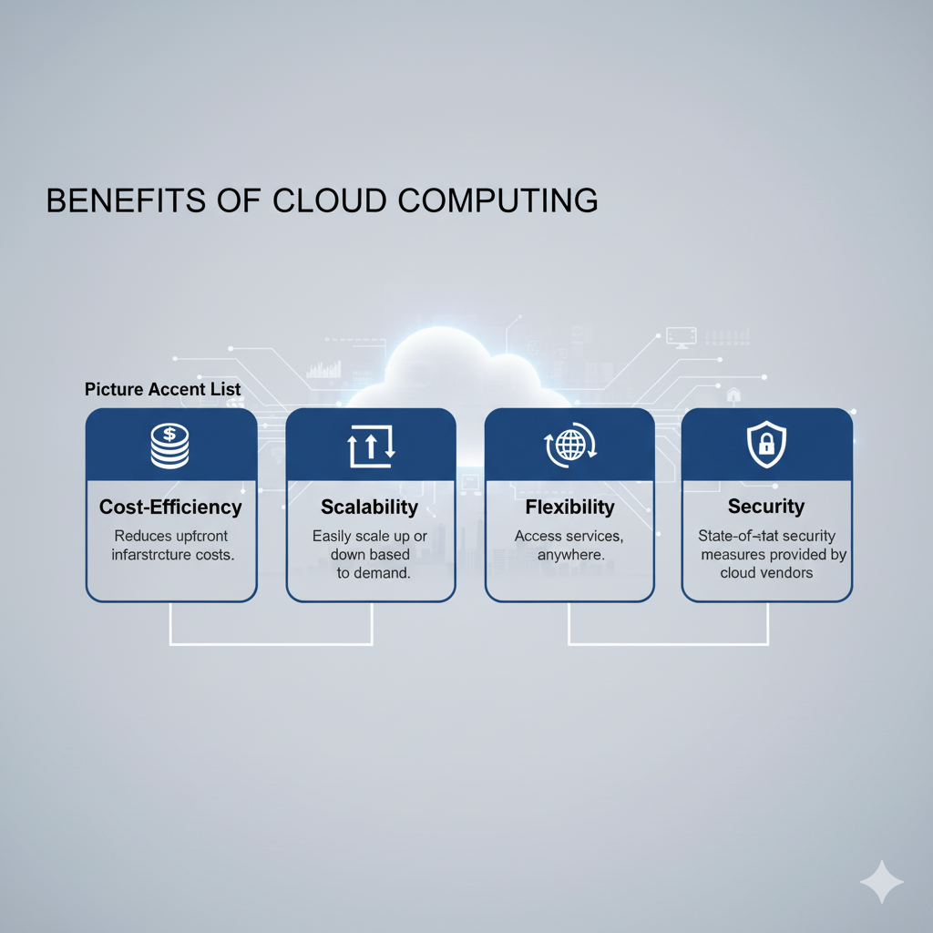
Benefits OF Cloud Computing
Cost Efficiency
Scalability
Flexibility
Security

Slide 5
Types OF Cloud Computing
IaaS ( Infrastructure as a Service )
PaaS ( Platform as a Service )
SaaS ( Software as a Service )

Slide 6
Security Of Cloud Computing

